Slide 1
Unit-2

Looping
What we will learn
If statement
Two way if statement
Nested if statement
Switch statement
Conditional Expression
While loop
Do-while loop
For loop
Nested loop
Break and continue statement
Common mathematical expression

Slide 2
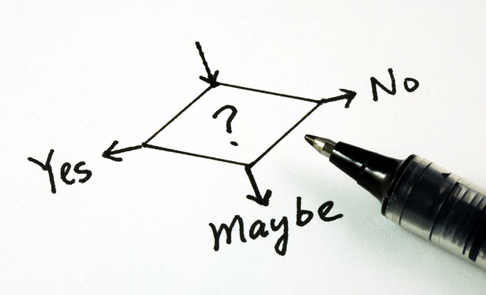

Slide 3
Decision Making
Compiler executes program statements sequentially.
Decision making statements are used to control the flow of program execution.
It allows us to control whether a set of program statement should be executed or not.
It evaluates condition or logical expression first and based on its result (true or false), the control is transferred to the particular statement.
If result is true then it takes one path else it takes another path.
True
condition
False
…
…
…

Slide 4
Decision Making Statements
Commonly used decision making statements are
One way Decision: if (Also known as simple if)
Two way Decision: if…else
Multi way Decision: if…else if…else if…else
Decision within Decision: nested if
Two way Decision: ?: (Conditional Operator)
n-way Decision: switch…case

Slide 5
if
One way Decision

Slide 6
if
if statement is the most simple decision-making statement also known as simple if.
An if statement consists of a boolean expression followed by one or more statements.
If the expression is true, then 'statement-inside' will be executed, otherwise 'statement-inside' is skipped and only 'statement-outside' will be executed.
It is used to decide whether a block of statements will be executed or not i.e if a certain condition is true then a block of statement is executed otherwise not.
condition
False
if(condition)
{
// Statements to execute if condition is true
}
True
statement-inside

Slide 7
WAP to print if a number is positive
import java.util.*;
class MyProgram{
public static void main (String[] args){
int x;
Scanner sc = new Scanner(System.in);
x = sc.nextInt();
if(x > 0){
System.out.println("number is a positive");
}
}

Slide 8
Exercise
Write a program which reads two numbers and based on different between it prints either of following message DIFFERENCE IS POSITIVE or DIFFERENCE IS NAGATIVE.

Slide 9
WAP to print if a number is odd or even
import java.util.*;
class MyProgram{
public static void main (String[] args){
int x;
Scanner sc = new Scanner(System.in);
x = sc.nextInt();
if( x % 2 == 1 ){
System.out.println("number is a odd");
}
if( x % 2 == 0 ){
System.out.println("number is a even");
}
}

Slide 10
if…else
Two way Decision

Slide 11
If…else
For a simple if, if a condition is true, the compiler executes a block of statements, if condition is false then it doesn’t do anything.
What if we want to do something when the condition is false? if…else is used for the same.
If the 'expression' is true then the 'statement-block-1' will get executed else 'statement-block-2' will be executed.
if(condition)
{
// statement-block-1
// to execute if condition is true
}
else
{
// statement-block-2
// to execute if condition is false
}
True
condition
False
statement-block-1
statement-block-2
…

Slide 12
WAP to print if a number is positive or negative
import java.util.*;
class MyProgram{
public static void main (String[] args){
int x;
Scanner sc = new Scanner(System.in);
x = sc.nextInt();
if (x > 0){
System.out.println("Number is positive");
}//if
else{
System.out.println("Number is negative");
}//else
}//main
}//class

Slide 13
WAP to print if a number is odd or even
import java.util.*;
class MyProgram{
public static void main (String[] args){
int x;
Scanner sc = new Scanner(System.in);
x = sc.nextInt();
if( x % 2 == 1 ){
System.out.println("number is a odd");
}
else{
System.out.println("number is a even");
}
}

Slide 14
Exercise
Any year is entered through the keyboard, write a program to determine whether the year is leap or not.
Write a program to check whether a triangle is valid or not, when the three angles of the triangle are entered through the keyboard. A triangle is valid if the sum of all the three angles is equal to 180 degrees.

Slide 15
if…else if…else
Multi way Decision

Slide 16
if…else if…else
if…else if…else statement is also known as if-else-if ladder which is used for multi way decision making.
It is used when there are more than two different conditions.
It tests conditions in a sequence, from top to bottom.
If first condition is true then the associated block with if statement is executed and rest of the conditions are skipped.
If condition is false then then the next if condition will be tested, if it is true then the associated block is executed and rest of the conditions are skipped. Thus it checks till last condition.
Condition is tested only and only when all previous conditions are false.
The last else is the default block which will be executed if none of the conditions are true.
The last else is not mandatory. If there are no default statements then it can be skipped.
if(condition 1)
{
statement-block1;
}
else if(condition 2)
{
statement-block2;
}
else if(condition 3)
{
statement-block3;
}
else if(condition 4)
{
statement-block4;
}
else
default-statement;

Slide 17
if-else-if ladder
condition1
False
if(condition 1)
{
statement-block1;
}
else if(condition 2)
{
statement-block2;
}
else if(condition 3)
{
statement-block3;
}
else if(condition 4)
{
statement-block4;
}
else
default-statement;
True
condition2
False
…
False
True
condition3
…
True
…
…

Slide 18
WAP to print if a number is zero or positive or negative
import java.util.*;
class MyProgram{
public static void main (String[] args){
int x;
Scanner sc = new Scanner(System.in);
x = sc.nextInt();
if(x > 0){
System.out.println(" number is a positive");
}
else if(x < 0) {
System.out.println(" number is a negative");
}
else{
System.out.println(" number is a zero");
}
}

Slide 19
WAP to print day name from day number
public class Demo {
public static void main(String[] args) {
int d;
Scanner sc = new Scanner(System.in);
d = sc.nextInt();
if (d == 1 ) System.out.println(“Monday”);
else if (d == 2) System.out.println(“Tuesday“);
else if (d == 3) System.out.println(“Wednesday“);
else if (d == 4) System.out.println(“Thursday“);
else if (d == 5) System.out.println(“Friday“);
else if (d == 6) System.out.println(“Saturday“);
else System.out.println(“Sunday“);
}
}

Slide 20
if-else statement
int marks = 65;
if (marks < 60) {
System.out.println("fail");
} else if (marks >= 60 && marks < 80) {
System.out.println("B grade");
} else if (marks >= 80 && marks < 90) {
System.out.println("A grade");
} else if (marks >= 90 && marks < 100) {
System.out.println("A+ grade");
} else {
System.out.println("Invalid!");
}

Slide 21
Nested If
A nested if is an if statement that is the target of another if statement.
Nested if statements mean an if statement inside another if statement.
The statement connected to the nested if statement is only executed when -:
condition of outer if statement is true, and
condition of the nested if statement is also true.
Note: There could be an optional else statement associated with the outer if statement, which is only executed when the condition of the outer if statement is evaluated to be false and in this case, the condition of nested if condition won't be checked at all.
if(condition 1)
{
if(condition 2)
{
nested-block;
}
else
{
nested-block;
}
}//if
else if(condition 3)
{
statement-block3;
}
else(condition 4)
{
statement-block4;
}

Slide 22
Nested If statement
We can also use if/else if statement inside another if/else if statement, this is known as nested if statement.
int username = Integer.parseInt(args[0]);
int password = Integer.parseInt(args[1]);
double balance = 123456.25;
if(username==1234){
if(password==987654){
System.out.println("Your Balance is ="+balance);
}
else{
System.out.println("Password is invalid");
}
}
else{
System.out.println("Username is invalid");
}

Slide 23
Exercise
In a company an employee is paid as under:
If his basic salary is less than Rs. 1500, then HRA = 10% of basic salary and DA = 90% of basic salary.
If his salary is either equal to or above Rs. 1500, then HRA = Rs. 500 and DA = 98% of basic salary.
Employee's salary is input through the keyboard, write a program to find his gross salary.

Slide 24
switch…case
n-way Decision

Slide 25
Switch…case
switch…case is a multi-way decision making statement.
It is similar to if-else-if ladder statement.
It executes one statement from multiple conditions.
switch (expression)
{
case constant 1:
// Statement-1
break;
case constant 2:
// Statement-2
break;
case constant 3:
// Statement-3
break;
default:
// Statement-default
// if none of the above case matches then this block would be executed.
}

Slide 26
Switch…case: WAP to print day based on number entered
switch (d) {
case 1:
System.out.println(“Monday“); break;
case 2:
System.out.println(“Tuesday“); break;
case 3:
System.out.println(“Wednesday“); break;
case 4:
System.out.println(“Thursday“); break;
case 5:
System.out.println(“Friday“); break;
case 6:
System.out.println(“Saturday“); break;
case 7:
System.out.println(“Sunday“); break;
default:
System.out.println(“Invalid Day“);
} //switch
}
}
public class Demo {
public static void main(String[] args){
int d;
Scanner sc= new Scanner(System.in);
d = sc.nextInt();

Slide 27
Switch…case
switch statement executes one statement from multiple conditions. It is like if-else-if ladder statement.
public class SwitchExampleDemo {
public static void main(String[] args)
{
int number = 20;
switch (number) {
case 10:
System.out.println("10");
break;
case 20:
System.out.println("20");
break;
default:
System.out.println("Not 10 or 20");
}
}
}

Slide 28
Exercise
Write a menu driven program that allows user to enters five numbers and then choose between finding the smallest, largest, sum or average. Use switch case to determine what action to take. Provide error message if an invalid choice is entered.

Slide 29
Points to remember for switch…case
The condition in the switch should result in a constant value otherwise it would be invalid.
In some languages, switch statements can be used for integer values only.
Duplicate case values are not allowed.
The value for a case must be of the same data type as the variable in the switch.
The value for a case must be a constant.
variables are not allowed as an argument in switch statement.
The break statement is used inside the switch to terminate a statement sequence.
The break statement is optional, if eliminated, execution will continue on into the next case.
The default statement is optional and can appear anywhere inside the switch block.

Slide 30
Exercise
Write a Java program to get a number from the user and print whether it is positive or negative.
Write a program to find maximum no from given 3 no.
The marks obtained by a student in 5 different subjects are input through the keyboard.
The student gets a division as per the following rules:
Percentage above or equals to 60-first division
Percentage between 50 to 59-second division
Percentage between 40 and 49-Third division
Percentage less than 40-fail
Write a program to calculate the division obtained by the student.
Write a Java program that takes a number from the user and displays the name of the weekday accordingly (For example if user enter 1 program should return Monday) .

Slide 31
Introduction to loop
Repeatedly execute a block of statements

Slide 32
Loop
Sometimes we need to repeat certain actions several times or till the some criteria is satisfied.
Loop constructs are used to iterate a block of statements several times.
Loop constructs repeatedly execute a block of statements for a fixed number of times or till some condition is satisfied
Flowchart of if (true-block executed only once)
Flowchart of while
(true-block executed till condition is true)
condition
False
condition
False
True
True
true-block
true-block

Slide 33
Looping Statements
Following are looping statements in any programming language,
Entry Controlled while, for
Exit Controlled do…while
Unconditional Jump goto (It is advised to never use goto in a program)

Slide 34
while
Entry Controlled Loop

Slide 35
while
while is a entry controlled loop.
It executes a block of statements till the condition is true.
while(condition)
{
// true-block
}
Flowchart of while
(true-block executed till condition is true)
condition
False
int i = 1;
while (i <= 5)
{
System.out.println(i);
i++;
}
True
true-block

Slide 36
While Loop
while loop is used to iterate a part of the program several times. while is entry control loop.
If the number of iteration is not fixed, it is recommended to use while loop.
//code will print 1 to 9
public class WhileLoopDemo {
public static void main(String[] args) {
int number = 1;
while(number < 10) {
System.out.println(number);
number++;
}
}
}

Slide 37
Do-while Loop
do-while loop is executed at least once because condition is checked after loop body.
//code will print 1 to 9
public class DoWhileLoopDemo {
public static void main(String[] args) {
int number = 1;
do {
System.out.println(number);
number++;
}while(number < 10) ;
}
}

Slide 38
WAP to print odd numbers between 1 to n
import java.util.*;
class WhileDemo{
public static void main (String[] args){
int n,i=1;
Scanner sc = new Scanner(System.in);
System.out.print("Enter a number:");
n = sc.nextInt();
while(i <= n){
if(i%2==1)
System.out.println(i);
i++;
}
}}
Output
Enter a number:10 1 3 5 7 9

Slide 39
WAP to print factors of a given number
import java.util.*;
class WhileDemo{
public static void main (String[] args){
int i=1,n;
Scanner sc = new Scanner(System.in);
System.out.print("Enter a Number:");
n = sc.nextInt();
System.out.print(" Factors:");
while(i <= n){
if(n%i == 0)
System.out.print(i +",");
i++;
}
}}
Output
Enter a Number:25 Factors:1,5,25

Slide 40
Exercise:while
WAP to print multiplication table using while loop
Write a program that calculates and prints the sum of the even integers from 1 to 10.

Slide 41
for(;;)
Entry Controlled Loop

Slide 42
for
for is an entry controlled loop
Statements inside the body of for are repeatedly executed till the condition is true
The initialization statement is executed only once, at the beginning of the loop.
Then, the condition is evaluated.
If the condition is true, statements inside the body of for loop are executed
If the condition is false, the for loop is terminated.
Then, increment / decrement statement is executed
Again the condition is evaluated and so on so forth till the condition is true.
for (initialization; condition; increment /decrement)
{
// statements
}
int i = 1;
while (i <= 5) {
System.out.print("Hell o World!");
i++;
}
for(i=1; i <= 5; i++)
{
System.out.print("Hello World!");
}

Slide 43
For Loop
for loop is used to iterate a part of the program several times.
If the number of iteration is fixed, it is recommended to use for loop.
//code will print 1 to 9
public class ForLoopDemo {
public static void main(String[] args)
{
for(int number=1;number<10;number++)
{
System.out.println(number);
}
}
}

Slide 44
WAP to print odd numbers between 1 to n
import java.util.*;
class MyProgram{
public static void main (String[] args){
int i=1;
Scanner sc = new Scanner(System.in);
n = sc.nextInt();
for(i=1; i<=n; i++) {
if(i%2==1)
System.out.println(i);
}//for
}//
}

Slide 45
WAP to print factors of a given number
import java.util.*;
class MyProgram{
public static void main (String[] args){
int i=1;
Scanner sc = new Scanner(System.in);
n = sc.nextInt();
for(i=1; i<=n; i++){
if(n%i == 0)
System.out.println(i);
}
}
}

Slide 46
Exercise: for
Write a program to print average of n numbers.
Write a program that calculates and prints the sum of the even integers from 1 to 10.

Slide 47
do…while
Exit Controlled Loop

Slide 48
do…while
do…while is an exit controlled loop.
Statements inside the body of do…while are repeatedly executed till the condition is true.
while loop executes zero or more times, do…while loop executes one or more times.
do
{
// true-block
}
while(condition) ;
Flowchart of while
Flowchart of do…while
condition
False
true-block
True
condition
true-block
True
False

Slide 49
WAP to print 1 to 10 using do-while loop
import java.util.*;
class MyProgram{
public static void main (String[] args){
int i=1;
do{
System.out.println(i);
i++;
}while(i <= 10);
}
}

Slide 50
continue
Skip the statement in the iteration

Slide 51
continue
Sometimes, it is required to skip the remaining statements in the loop and continue with the next iteration.
continue statement is used to skip remaining statements in the loop.
continue is keyword.

Slide 52
WAP to calculate the sum of positive numbers.
import java.util.*;
class ContinueDemo{
public static void main(String[] args) {
int a,n,sum=0;
Scanner sc = new Scanner(System.in);
n = sc.nextInt();
for(int i=0;i<n;i++){
a = sc.nextInt();
if(a<0){
continue;
System.out.println("a="+a);//error:unreachable statement
}//if
sum=sum+a;
}//for
System.out.println("sum="+sum);
}
}

Slide 53
break
Early exit from the loop

Slide 54
break
Sometimes, it is required to early exit the loop as soon as some situation occurs.
E.g. searching a particular number in a set of 100 numbers. As soon as the number is found it is desirable to terminate the loop.
break statement is used to jump out of a loop.
break statement provides an early exit from for, while, do…while and switch constructs.
break causes exit from the innermost loop or switch.
break is keyword.

Slide 55
WAP to calculate the sum of given numbers. User will enter -1 to terminate.
import java.util.*;
class BreakDemo{
public static void main (String[] args){
int a,sum=0;
System.out.println("enter numbers_ enter -1 to break");
Scanner sc = new Scanner(System.in);
while(true){
a = sc.nextInt();
if(a==-1)
break;
sum=sum+a;
}//while
System.out.println("sum="+sum);
}
}

Slide 56
Types of loops
Entry Control Loop
Entry Control Loop
Exit Control Loop
Virtual Loop
int i=1;
while(i<=10)
{
i++;
}
int i;
for(i=1;i<=10;i++)
{
i++;
}
int i=1;
do
{
i++;
}
while(i<=10);
int i=1;
p: i++;
if(i<=10)
goto p;
condition
False
Label
Statement
Loop Body
True
True
condition
True
condition
Loop Body
False
goto
label
False

Slide 57
nested loop
loop within a loop

Slide 58
WAP to print given pattern (nested loop)
*
**
***
****
*****
class PatternDemo{
public static void main(String[] args) {
int n=5;
for(int i=1;i<=n;i++){
for(int j=1;j<=i;j++){
System.out.print("*");
}//for j
System.out.println();
}//outer for i
}
}

Slide 59
WAP to print given pattern (nested loop)
1
1 2
1 2 3
1 2 3 4
1 2 3 4 5
class PatternDemo{
public static void main(String[] args) {
int n=5;
for(int i=1;i<=n;i++){
for(int j=1;j<=i;j++){
System.out.print(j+"\t");
}//for j
System.out.println();
}//outer for i
}
}

Slide 60
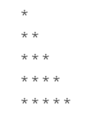
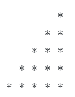
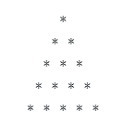
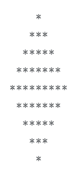
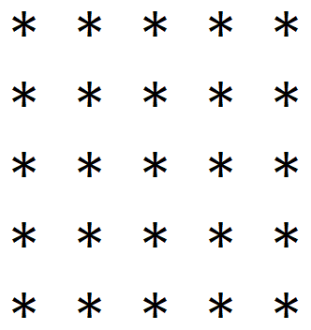
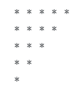

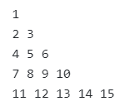
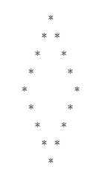
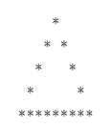
Programs to perform (Looping Statements)
Write a program to print first n odd numbers.
Write a program to check that the given number is prime or not.
Write a program to draw given patterns,

Slide 61

Mathematical functions

Slide 62
Math class
The Java Math class provides more advanced mathematical calculations other than arithmetic operator.
The java.lang.Math class contains methods which performs basic numeric operations such as the elementary exponential, logarithm, square root, and trigonometric functions.
All the methods of class Math are static.
Fields :
Math class comes with two important static fields
E : returns double value of Euler's number (i.e 2.718281828459045).
PI : returns double value of PI (i.e. 3.141592653589793).

Slide 63
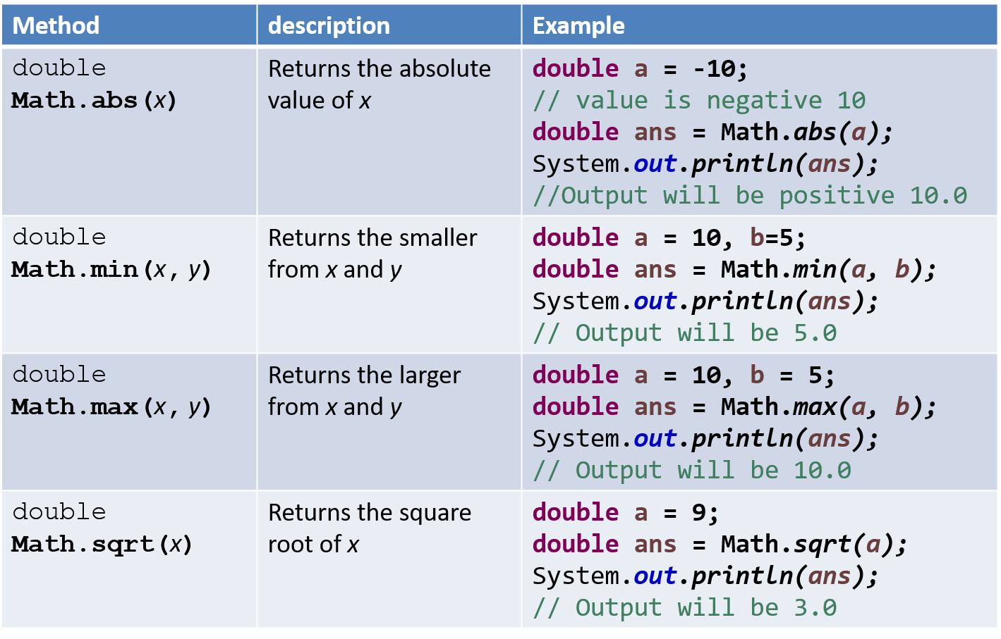
Methods of class Math

Slide 64
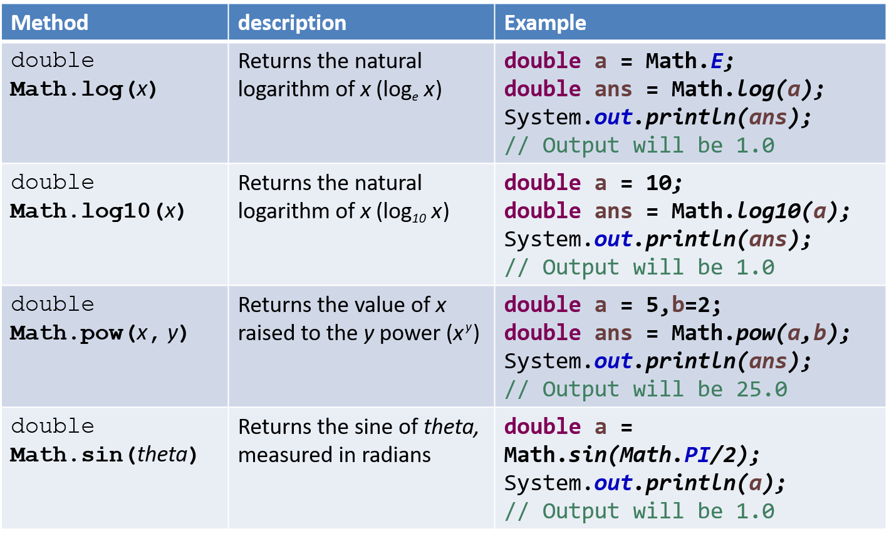
Methods of class Math (Cont.)

Slide 65
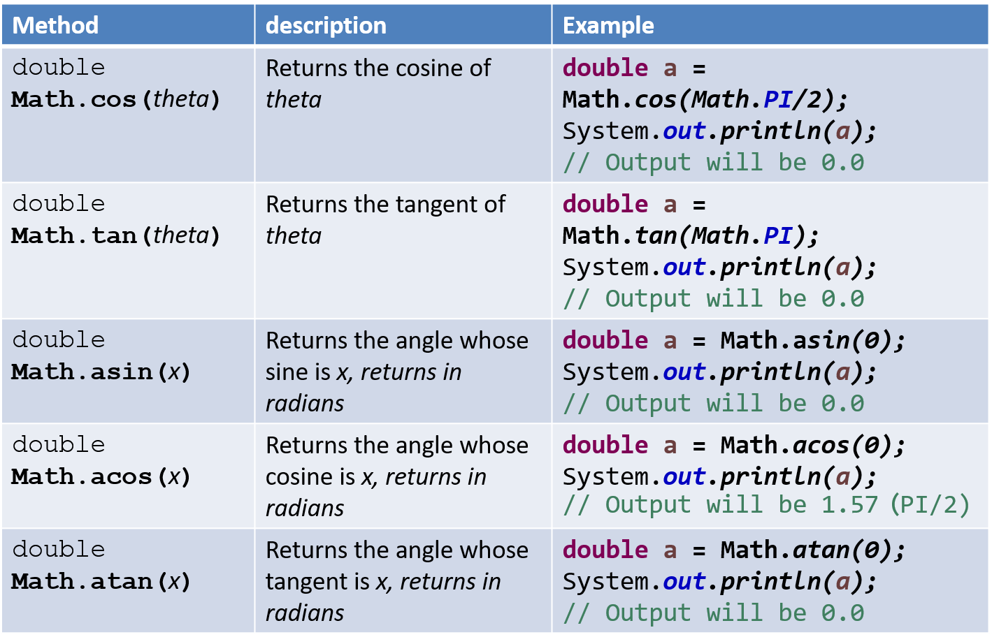
Methods of class Math (Cont.)

Slide 66
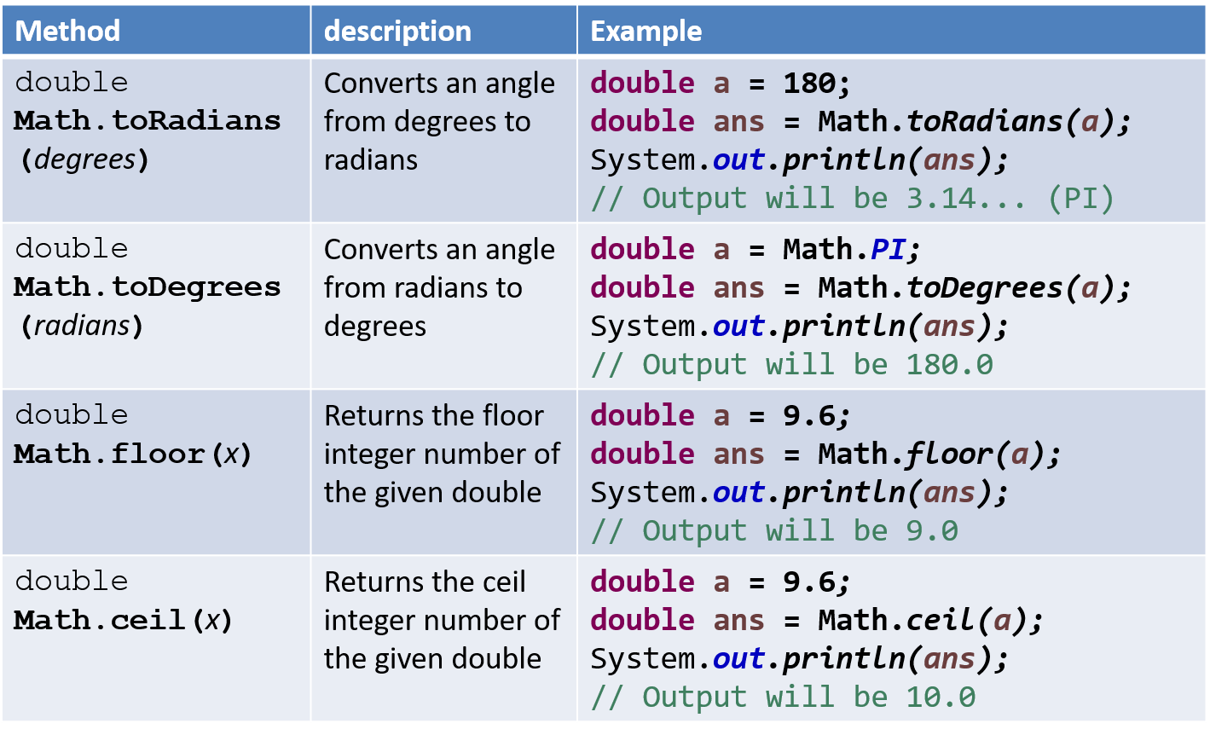
Methods of class Math (Cont.)

Slide 67
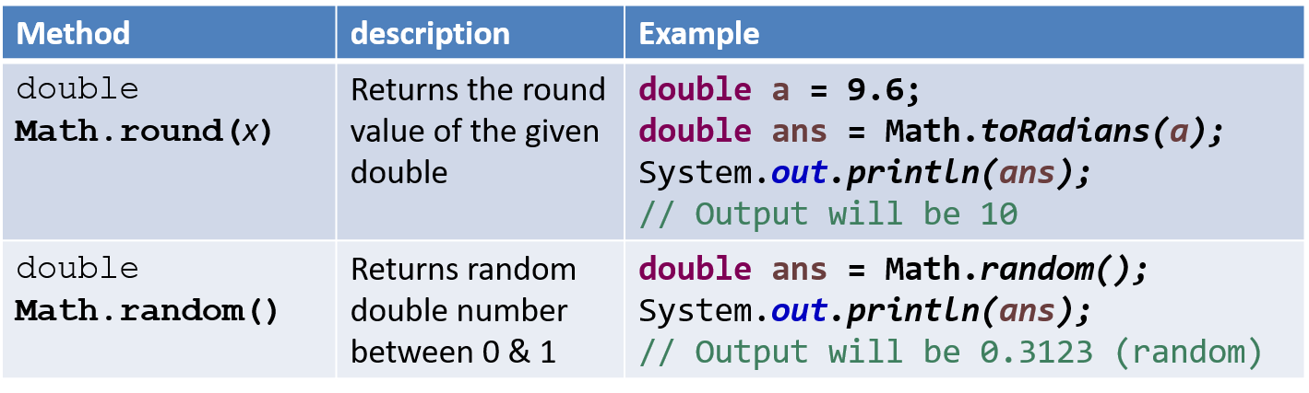
Methods of class Math (Cont.)

Slide 68
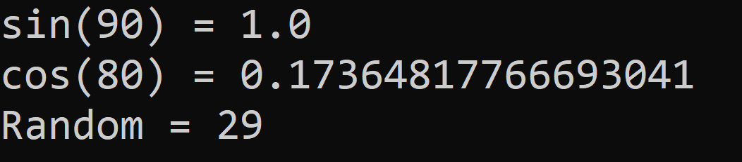
Math Example
public class MathDemo {
public static void main(String[] args) {
double sinValue = Math.sin(Math.PI / 2);
double cosValue = Math.cos(Math.toRadians(80));
int randomNumber = (int)(Math.random() * 100);
// values in Math class must be given in Radians
// (not in degree)
System.out.println("sin(90) = " + sinValue);
System.out.println("cos(80) = " + cosValue);
System.out.println("Random = " + randomNumber);
}
}

Slide 69
Thank You

